Slide 1

EASP (Efficient Automated Service Provider)
Supervisor: Mr. uzair saeed

Slide 2
Abstract
Our vision is to facilitate people and businesses in outsourcing their work; whether you’re seeking employment or want a worker to carry out a specific task, we can assist you in finding the best match. As the main theme of this application is to minimize the gap between seekers and service providers, this application will act as a bridge between these entities.
We have gathered all requirements and did our competitive requirements elicitation. We have narrow down our competitor’s problems and we will use them to our advantage. All their missing and best features are a core part of our web application, this can give us an overall edge to our competitors
Notes:
Please remove this slide from your final presentation, the contents on this slide are a description about this template and how P@SHA wants you to use it.

Slide 3
Problem Statement
In Pakistan more than 20% of population is getting minimum daily wage of 3 dollar.
These people are skilled personals that do technical stuff to get these wages.
In Pakistan we find no or close to none service providing apps that can add some extra income to their salary.
Skilled people are working in their limited market and they are known in a very little market.
People or service seekers heads to big commercial markets for their work that is causing a huge market gap for small vendors and skill labor.

Slide 4
Objectives
Our vision is to facilitate people and businesses in outsourcing their work; whether you're seeking employment or want a worker to carry out a specific task, we can assist you in finding the best match. Skilled people may make extra money using our website.
The key features of our project are:
There will be no constraint on the type of service that can be found in the platform.
The user can be both an employer and an employee simultaneously.
Rank and update service providers with users' new tasks that are located within a 5-kilometer distance around them.

Slide 5
Cont.
Users and service providers can negotiate a price.
Service provider lists his specialty along with prices.
There may or might not be a delivery charge (totally depends on the service provider).
The website will allow you to communicate with the service provider.
Users will receive a message by hiring a service provider.
We will ensure that this platform uses the internet as little as possible.
Our assessment officer will assess the service provider's profile.
A person's profile will be raised if he accomplishes a set of objectives and tasks within a predetermined window of time.

Slide 6
Methodology
Agifall (Waterfall + Agile) approach is being used by ESAP. It combines the best of waterfall and agile by injecting the agile into a loose waterfall process.
The aim of Agifall is to increase the speed, decrease the cost and improve the quality.
Agifall approaches planning in a user-centric manner and use quick prototype tools.

Slide 7
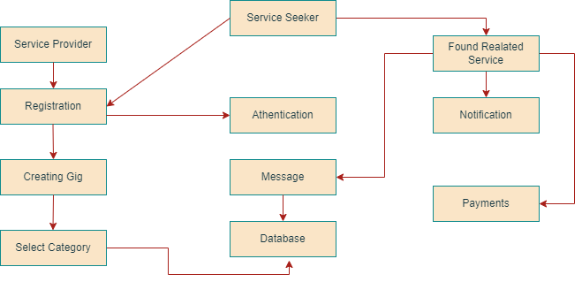
Block Diagram

Slide 8
Features & Functions
Features and Functions:
No constraints on type of service.
The user can be a service provider and seeker or both.
There will be rank system to prioritize best service providers.
Task will be visible to only people in a 5 km radius.
Prices will be negotiable.

Slide 9
Cont.
Features and Functions:
List of service providers with their respective skills and prices.
Message feature between users.
Minimum usage of internet.
Automated system to filter their profiles to avoid controversial content.
Awards set on goals and objectives.

Slide 10
Gantt Chart
TASK | SEP | OCT | NOV | DEC | JAN | FEB | MAR | APR | MAY | JUNE
Project Planning | 29 | 24
Requirements Gathering |  |  |  | 01 | 30
Document Phase 1 |  |  | 14 | 30
Design |  |  | 01 | 30
Coding |  |  |  |  |  | 01 |  | 30
Implementation |  |  |  |  |  |  |  |  | 30
Testing |  |  |  |  |  |  |  |  | 30
Verification |  |  |  |  |  |  |  |  |  | 30

Slide 11
Constraints
We didn’t find any major constraints to our application as there are very minimal requirements that we need. And we also didn’t find any government policies and regulations related to our app, But I think our main issue can be:
Person’s verification

Slide 12
Market / Competition
We have compared our project with other market competitors such as
SuperTasker,
Maher
Services Finder.
All of these applications are company based and some of them are working and some are not. The following table is showing the comparison according to the features:

Slide 13
Comparison Table
Features | (Maher, 2020) | (SuperTasker.pk, 2019) | (Services Finder, 2018) | EASP
For Freelancers | ▪ | ✔ | ▪ | ✔
Services Category | ▪ | ▪ | ✔ | ✔
Backend Support | ▪ | ✔ | ▪ | ✔
Chat Support | ▪ | ▪ | ▪ | ✔
User can Post Service | ✔ | ▪ | ▪ | ✔
Client can Post Task | ▪ | ✔ | ▪ | ▪
Gig Posting | ▪ | ▪ | ▪ | ✔
Map Support | ▪ | ▪ | ▪ | ✔

Slide 14
Tools and Technology
IDE: Visual Studio Code
Front-End:​ HTML, CSS, Boot strap, JavaScript, React.js
Back-End: Nodejs, Express js
Database: MongoDB

Slide 15
Milestones/Deliverables
Requirements Elicitation ✔
Documentation Phase 1 ✔
Logical Design and Architecture ✔
Frontend ✔
Database Schema & Connection ✔
Remaining work:
Backend Implementation
Map Integration

Slide 16
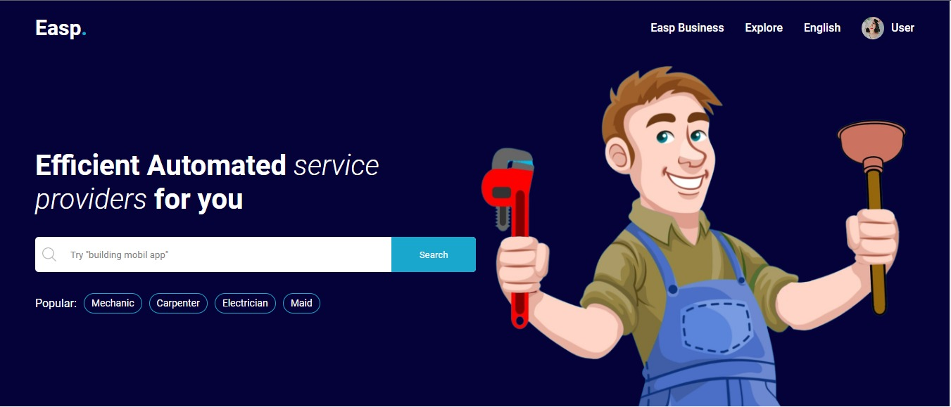
Dashboard

Slide 17
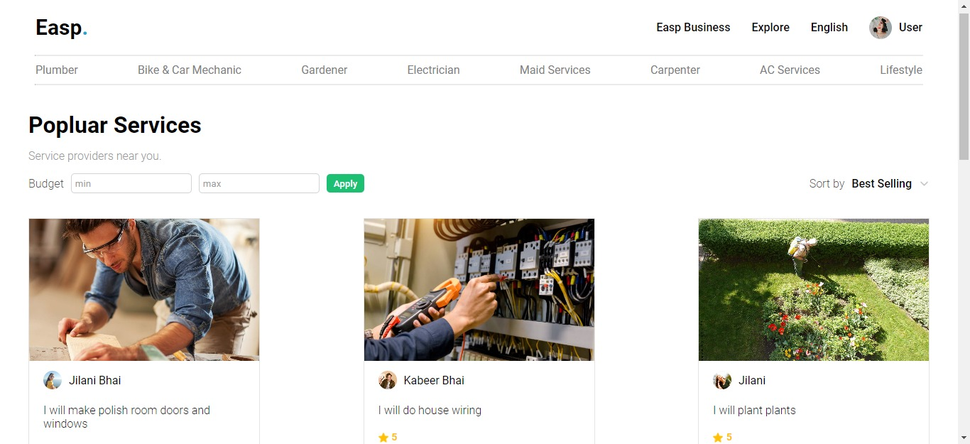
Popular Services

Slide 18
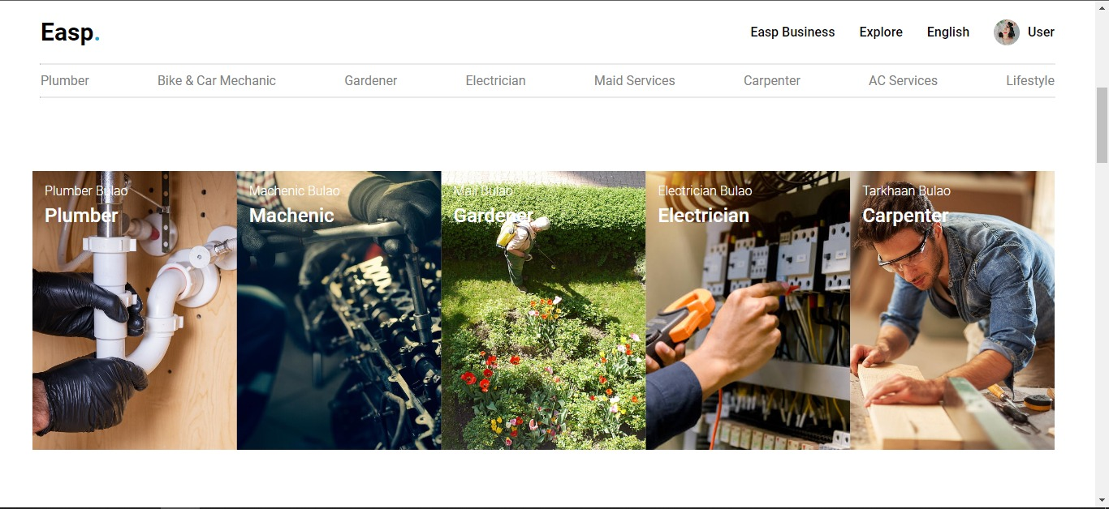
Popular Categories

Slide 19
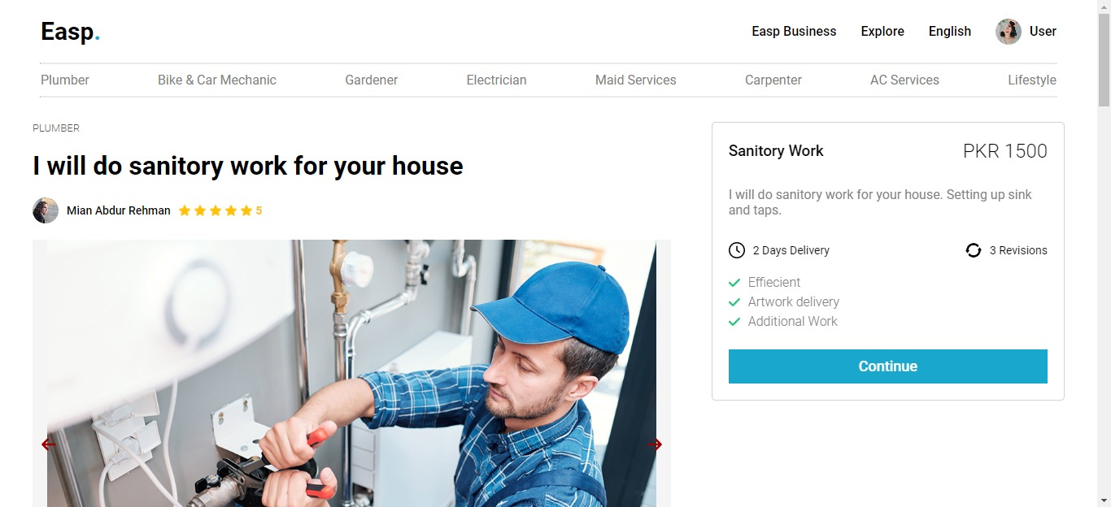
Single Service/Gig

Slide 20
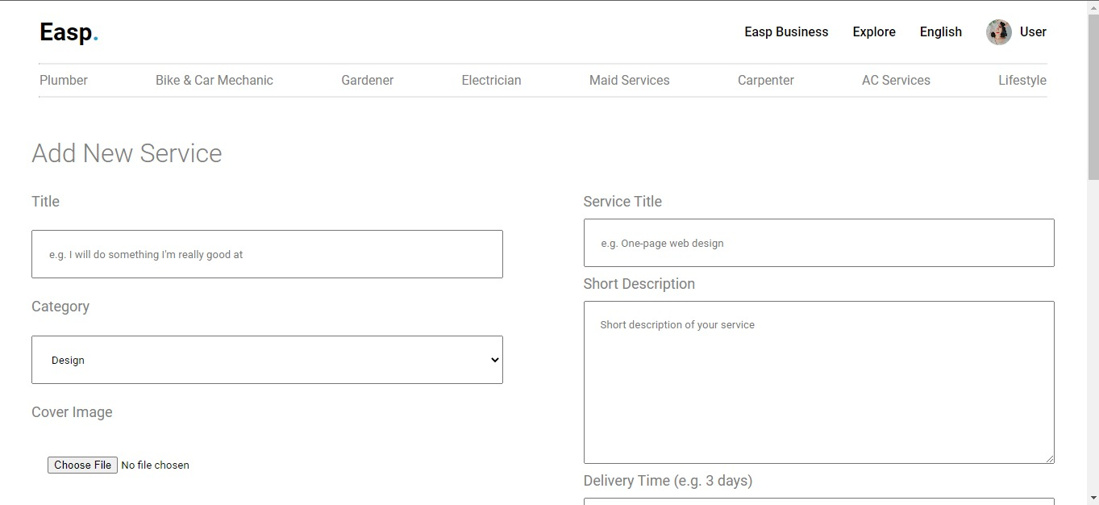
Add New Service/Gig

Slide 21
Our Team
Abdur Rehman
React.js
Node.js
Ahmad Jilani
HTML
CSS3
Muhammad Kabeer
React.js
Express.js
Bootstrap
MongoDB
MYSQL
MongoDB

Slide 22
Thank you

Slide 23
Q&A
Any Question

